Slide 1

Digital Logic/Breadboard
OCP

Slide 2

Boolean Logic
3 Primary Operators
AND, OR, NOT
# of outcomes depends on number of inputs
$$outcomes=2^{\# of inputs}$$
Two states for a Binary Signal
TRUE | FALSE
On | Off
1 | 0
5 volts (or less in modern circuits) | 0 volts

Slide 3

Digital Logic Gates
The “AND” Gate
If both inputs are true, then output true
A | B | Output (Q)
0
0
0
0
1
0
1
0
0
1
1
1
Wiring Symbol:
Math Symbol:
Boolean Equation:
A
Q
* x ∙ ()
A ∙ B = Q
B

Slide 4
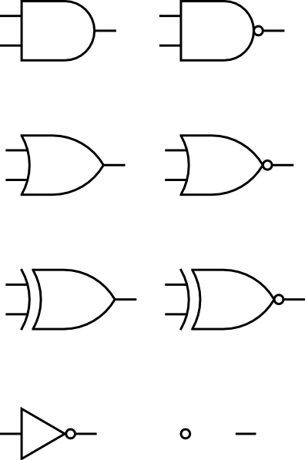
Digital Logic Gates
The “OR” Gate
If either input is true, then output true
A | B | Output (Q)
0
0
0
0
1
1
1
0
1
1
1
1
Wiring Symbol:
Math Symbol:
Boolean Equation:
A
Q
+
A + B = Q
B

Slide 5

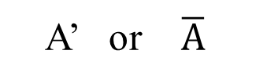
Digital Logic Gates
The “NOT” Gate
Output is opposite of the input
A | Output (Q)
0
1
1
0
Wiring Symbol:
Math Symbol:
Boolean Equation:
A
A’
A’ or $\overline{A}$
A’ = Q

Slide 6
Boolean Algebra
Identity Element
a+0=a
a+1=1
a*0=0
a*1=a
Involution
(a')'=a
Complementation
a+a'=1
a*a'=0
Idempotency
a+a=a
a*a=a
Associative (grouping doesn't matter)
a+(b+c)=(a+b)+c
a*(b*c)=(a*b)*c
Commutative (order doesn't matter)
a+b=b+a
a*b=b*a
Distributive for BOOLEAN ALGEBRA
a+(b*c)=(a+b)*(a+c)
a*(b+c)=(a*b)+(a*c)
Absorption
a+a*b=a
Adjacency
a*b+a*b'=a

Slide 7
Combinations and Simplifications (using Boolean Algebra)
A + A’ = 1
A · 1 = A
A + 1 = 1
1 + 0 =
1
1 · 1 =
1
1 + 1 =
1
0 + 1 =
1
0 · 1 =
0
0 + 1 =
1
Notes:
These are the three most useful boolean identities, for this class. There are a number more discussed in your reading, that you are welcome to use.

Slide 8
Logic Circuit Example Problem
At a particular zoo, some of the Lions are grouped together and given a large, open common area to use.
All of the animals have separate cages, but can access the common area at will, through a door in their cages.
The zookeepers must sometimes go into the common area to do routine tasks such as cleaning, replacing plants, and other maintenance.
Three of the Lions (Showoff, Grumpy, and Lady) are dangerous to zookeepers under certain conditions.
See next slide for details
Your task is to design a silent (i.e., LIGHT) alarm that will warn the zookeepers if it is dangerous to be in the common area.

Slide 9



S
G
L
Step 1: Determine Inputs and Outputs
Showoff is not dangerous by himself, but if any of the others are present they will hunt anyone in the common area.
Grumpy gets agitated when his mate (Lady) is not present, and will hunt the zookeeper under those conditions, but .
Lady will hunt with Showoff, but will calm Grumpy and the pair (Lady and Grumpy) are not dangerous when alone together.
Common Area Safe to enter?

Slide 10
Step 1: Determine Inputs and Outputs
How many inputs?
What are the inputs?
How many outputs?
What are the outputs?
3
1. Showoff is present
2. Grumpy is present
3. Lady is present
1
Silent Alarm

Slide 11
Step 2: Derive the Truth Table
Showoff is not dangerous by himself, but if any of the others are present they will hunt anyone in the common area.
Grumpy gets agitated when his mate (Lady) is not present, and will hunt the zookeeper under those conditions, but .
Lady will hunt with Showoff, but will calm Grumpy, and the pair (Lady and Grumpy) are not dangerous when alone together.
S | G | L | SILENT ALARM
0 | 0 | 0
0 | 0 | 1
0 | 1 | 0
0 | 1 | 1
1 | 0 | 0
1 | 0 | 1
1 | 1 | 0
1 | 1 | 1
0
0
1
0
0
1
1
1

Slide 12
Step 3: Write the Logic Equation from Truth Table - Use only those inputs where the alarm goes off… where the answer is SILENT ALARM = 1 (ON)
S | G | L | SILENT ALARM
0 | 0 | 0 | 0
0 | 0 | 1 | 0
0 | 1 | 0 | 1
0 | 1 | 1 | 0
1 | 0 | 0 | 0
1 | 0 | 1 | 1
1 | 1 | 0 | 1
1 | 1 | 1 | 1

Slide 13
Step 3: Write the Logic Equation from Truth Table - use only those inputs where the alarm goes off… where the answer is SILENT ALARM = 1 (ON)
S | G | L | SILENT ALARM
0 | 0 | 0 | 0
0 | 0 | 1 | 0
0 | 1 | 0 | 1
0 | 1 | 1 | 0
1 | 0 | 0 | 0
1 | 0 | 1 | 1
1 | 1 | 0 | 1
1 | 1 | 1 | 1
S’·G ·L’
S·G’ ·L
S·G ·L’
S·G ·L

Slide 14
In words, the Truth Table says the Alarm will go off if:
S is not there and G is there and L is not there → S’·G ·L’
or
S is there and G is not there and L is there → S·G’ ·L
or
S is there and G is there and L is not there → S·G ·L’
or
S is there and G is there and L is there → S·G·L
… as a complete equation this is …
ALARM = S’ ·G ·L’ + S ·G’ ·L + S·G·L’ + S·G·L

Slide 15
Step 4: Simplify the Boolean Logic Equation ALARM = S’ ·G ·L’ + S ·G’ ·L + S·G·L’ + S·G·L Rearrange to put terms with common variables together ALARM = S’ ·G ·L’ + S·G·L’ + S ·G’ ·L + S·G·L Pull out like terms ALARM = G ·L’(S’+S) + S ·L(G’+G) From Boolean Identities , recall that a + a’ = 1 (that is, a or a’ = 1) so reduce to
ALARM = G ·L’(1) + S ·L(1) Again, recall from Boolean Identities that a*1 = a (that is, a and 1 = a) so reduce to
ALARM = G·L’ + S·L
In Words: The alarm will sound if Grumpy is present AND NOT Lady, OR if Showoff AND Lady are present together.

Slide 16
Step 5: Draw simplified circuit
ALARM = G·L’ + S·L
L’
GL’
L
G
GL’+SL
Alarm
SL
S

Slide 17
Step 6: Implement in Hardware
What does this really look like?
Need:
NOT (1)
AND (2)
OR (1)

Slide 18
L
G
Alarm
S
NOT
AND
OR

Slide 19
Chip 04
NOT Gate (‘)
Chip 08
AND gate (x)
Chip 32
OR gate (+)

Slide 20
We should adjust our diagram to show pin numbers
L
1
2
1
3
2
G
1
3
Alarm
2
4
6
S
5
NOT
AND
OR

Slide 21
L
L’
G
S
GL’ + SL
ALARM

Slide 22
We should adjust our diagram to show pin numbers
L
1
L’
2
3
4
5
6
G
1
2
3
S
4
5
6
1
GL’ + SL
ALARM
2
3
4
5
6

Slide 23
Troubleshooting
When you get stuck, try on your own (in your group) to figure out what’s wrong.
In the context of this course, it is always safe to connect a multimeter in volt mode.
The simplest thing to do is check voltages down the chain of your circuit to see whether it matches your expectation.
power supply providing 5V/ground?
breadboard rails providing 5V/ground?
circuit inputs?
intermediate connections?
circuit output?

Slide 24
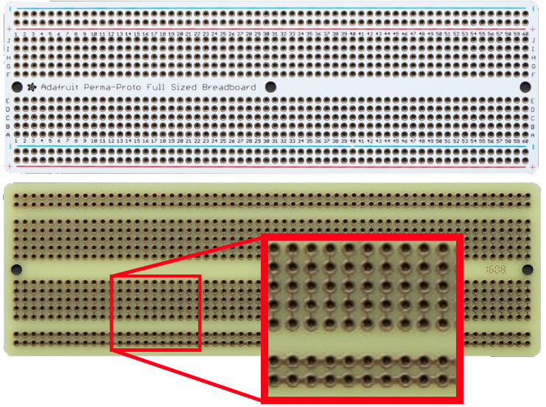
Breadboard

Slide 25
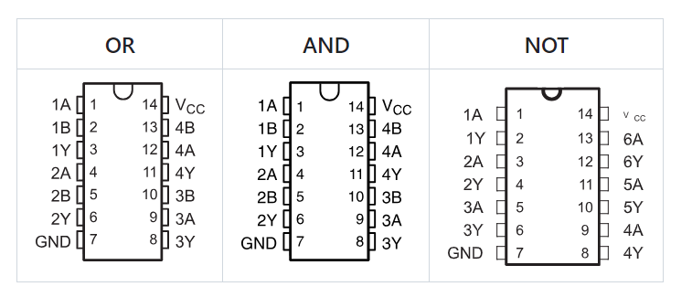
Gates

